Slide 1
Advanced Cloud Computing

Slide 2
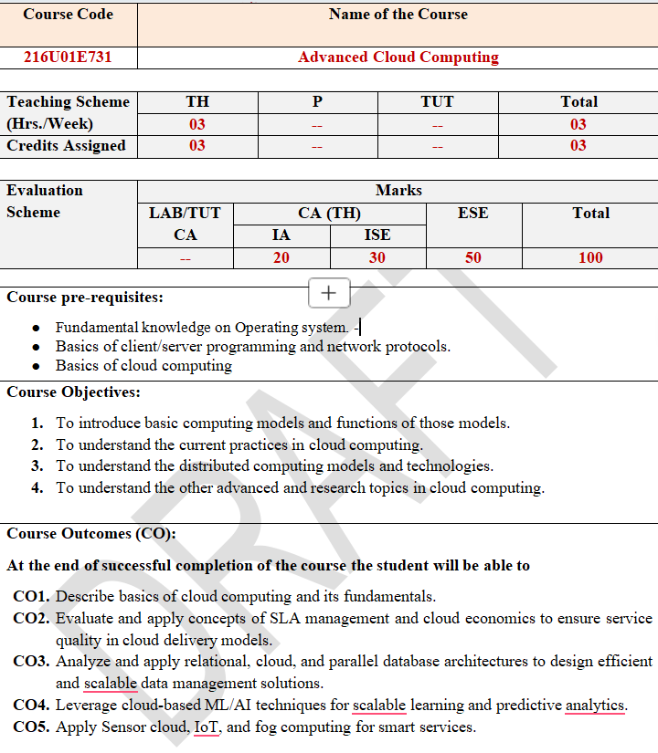
Advanced Cloud Computing

Slide 3
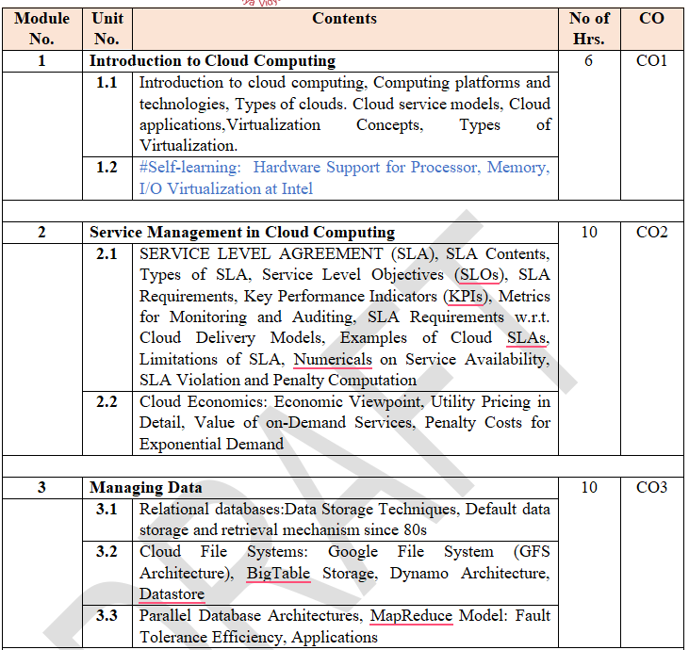

Slide 4
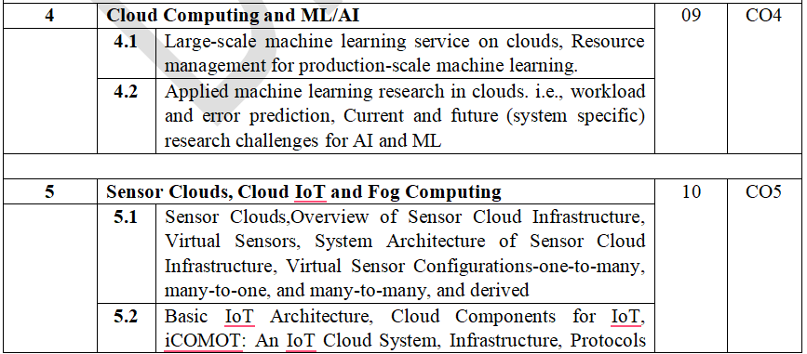
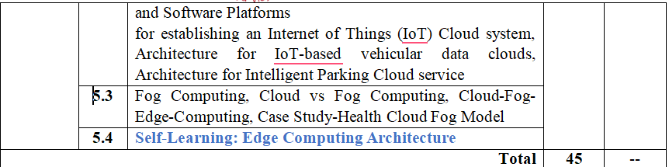

Slide 5
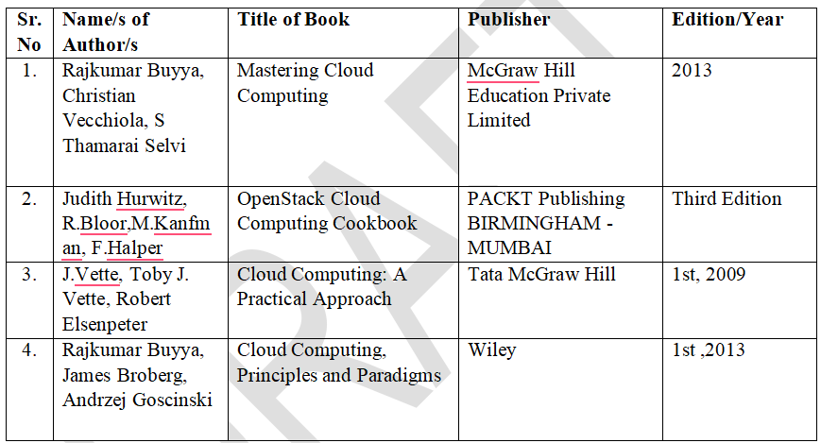

Slide 6
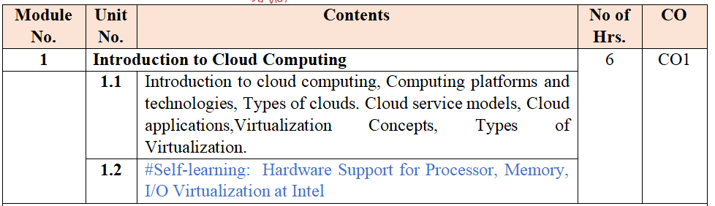

Slide 7
Introduction to Cloud Computing
Cloud computing is the on-demand delivery of computing services over the internet. Instead of buying, owning, and maintaining physical servers and data centers, you rent access to storage, databases, networking, and software from a cloud provider (like AWS, Microsoft Azure, or Google Cloud) on a pay-as-you-go basis.
Think of it like electricity: when you plug a lamp into the wall, you don't need to know how the power plant works or own the generators. You just use the electricity and pay for what you consume.

Slide 8
Introduction to Cloud Computing
Cloud computing allows anyone with a credit card to provision virtual hardware, runtime environments, and services.
The entire stack of a computing system is transformed into a collection of utilities, which can be provisioned and composed together to deploy systems in hours rather than days and with virtually no maintenance costs.
The long-term vision of cloud computing is that IT services are traded as utilities in an open market, without technological and legal barriers.

Slide 9
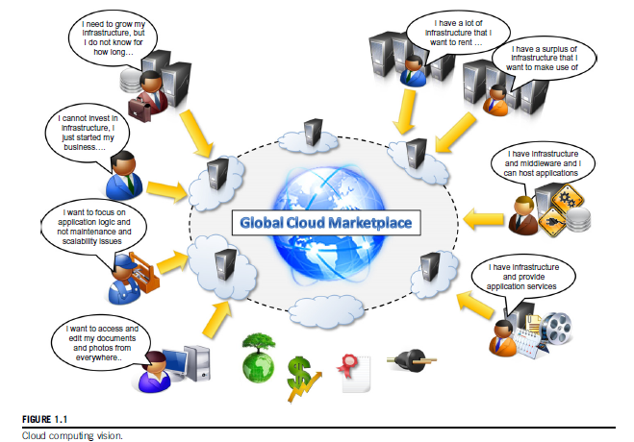
Introduction to Cloud Computing

Slide 10
Introduction to Cloud Computing
Cloud computing is helping enterprises, governments, public and private institutions, and research organizations shape more effective and demand-driven computing systems.
Practical examples
  Large enterprises can offload some of their activities to cloud-based systems.
  Small enterprises and start-ups can afford to translate their ideas into business results more quickly, without excessive up-front costs

Slide 11
Introduction to Cloud Computing
  System developers can concentrate on the business logic rather than dealing with the complexity of infrastructure management and scalability.
    Little Fluffy Toys is a company in London that has developed a widget providing users with information about nearby bicycle rental services. The company has managed to back the widget’s computing needs on Google AppEngine and be on the market in only one week.
    - End users can have their documents accessible from everywhere and any device

Slide 12
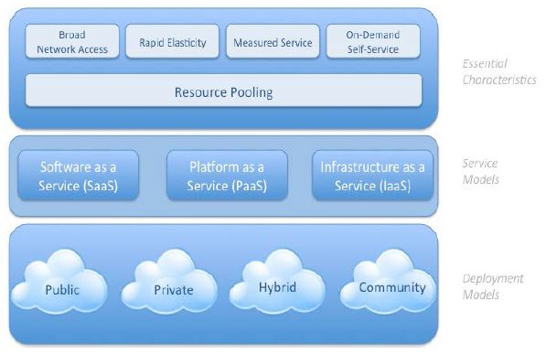
Introduction to Cloud Computing
  NIST (National Institute of Standards and Technology)Cloud computing definition: Cloud computing is a model for enabling ubiquitous, convenient, on-demand network access to a shared pool of configurable computing resources (e.g., networks, servers, storage, applications, and services) that can be rapidly provisioned and released with minimal management effort or service provider interaction

Slide 13
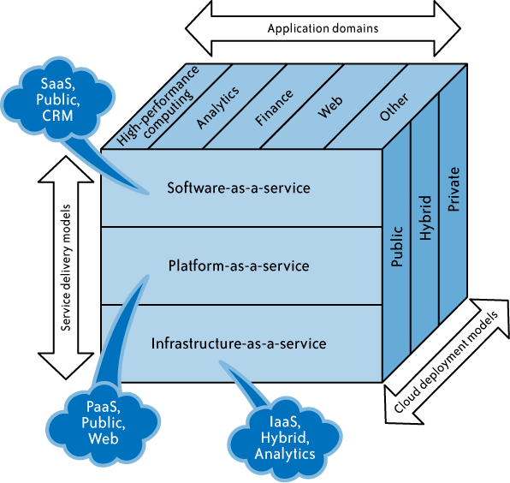
Introduction to Cloud Computing
  NIST Cloud computing definition:

Slide 14
Introduction to Cloud Computing
  NIST Cloud computing definition:

Slide 15
Introduction to Cloud Computing
Core Benefits of Cloud Computing
Cost Efficiency: Eliminates the massive upfront capital expenses (CapEx) of buying hardware and software. You only pay for what you use (OpEx).
Speed & Agility: Vast amounts of computing resources can be provisioned in minutes with a few clicks, giving businesses immense flexibility.
Global Scale: The ability to deploy apps globally at a moment's notice. You can scale your resources up or down instantly based on demand.
Productivity: It removes the need for "racking and stacking"—no hardware setup, software patching, or time-consuming IT management chores.
Reliability: Cloud providers offer data backup, disaster recovery, and business continuity features that are much easier and less expensive to implement than traditional on-premise systems.

Slide 16
Introduction to Cloud Computing
The 3 Main Cloud Service Models
Cloud computing is generally broken down into three primary service models, often referred to as the "cloud computing stack."
1. Infrastructure as a Service (IaaS)
This is the most basic category. You rent IT infrastructure—servers, virtual machines (VMs), storage, networks, and operating systems—from a cloud provider.
Analogy: Renting an empty plot of land. You have to build the house yourself.
Examples: Amazon EC2, Microsoft Azure VMs, Google Compute Engine.

Slide 17
Introduction to Cloud Computing
The 3 Main Cloud Service Models
2. Platform as a Service (PaaS)
PaaS provides an environment for building, testing, and managing applications. It’s designed to let developers focus on writing code without worrying about managing the underlying infrastructure (servers, storage, and databases).
Analogy: Renting an unfurnished apartment. The structure is there, but you bring your own stuff (your code).
Examples: Heroku, AWS Elastic Beanstalk, Google App Engine.

Slide 18
Introduction to Cloud Computing
The 3 Main Cloud Service Models
3. Software as a Service (SaaS)
SaaS is a method for delivering software applications over the internet, usually on a subscription basis. The cloud provider hosts and manages the application and its underlying infrastructure.
Analogy: Staying in a hotel room. Everything is provided, and you just use it.
Examples: Netflix, Google Workspace (Gmail, Docs), Microsoft 365, Salesforce.

Slide 19
Introduction to Cloud Computing
Types of Cloud Deployments
Not all clouds are the same. There are three main ways to deploy cloud resources:
Public Cloud: Owned and operated by a third-party provider. You share the same hardware, storage, and network devices with other "tenants" (e.g., AWS, Azure).
Private Cloud: Cloud infrastructure used exclusively by a single business or organization. It can be physically located at the company’s on-site datacenter or hosted by a third party.
Hybrid Cloud: This combines public and private clouds, bound together by technology that allows data and applications to be shared between them. It gives businesses greater flexibility and more deployment options.

Slide 20
Cloud computing platforms and technologies
The Big Three "Hyperscalers"
The global cloud infrastructure market is dominated by three main providers, often called hyperscalers, alongside specialized enterprise platforms.

Slide 21
Cloud computing platforms and technologies
Cloud Computing platforms:
Cloud computing platforms provide on-demand access to computing resources such as servers, storage, databases, networking, software, and analytics over the internet. Instead of buying and maintaining physical infrastructure, organizations can rent resources and pay only for what they use.

Slide 22
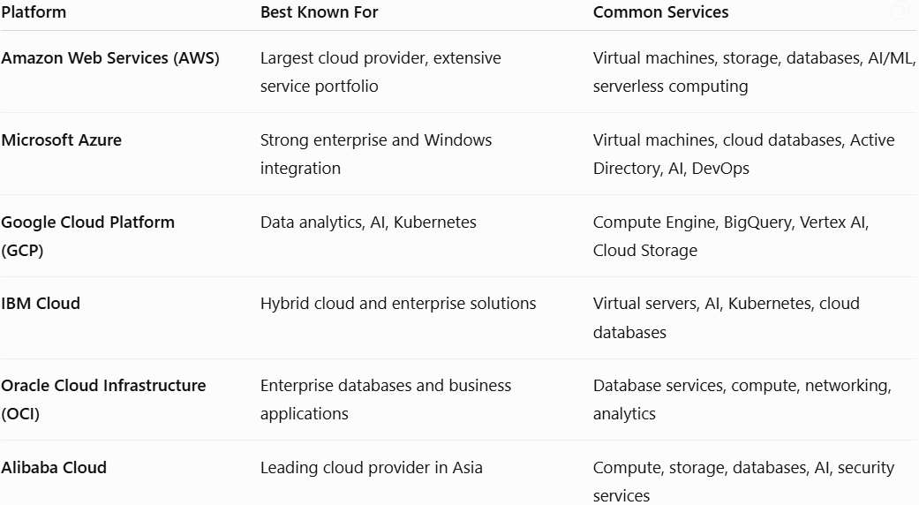
Cloud computing platforms and technologies
Here are some of the leading cloud computing platforms:

Slide 23
Cloud computing platforms and technologies
Here are some of the leading cloud computing platforms:
Amazon Web Services (AWS)
Amazon Web Services (AWS) is a cloud computing platform provided by Amazon. It offers a wide range of on-demand cloud services, including computing power, storage, databases, networking, analytics, artificial intelligence (AI), and security. AWS follows a pay-as-you-go pricing model, allowing users to pay only for the resources they use.
Key Features
Scalability: Easily increase or decrease resources based on demand.
Reliability: High availability through multiple global data centers.
Security: Built-in identity management, encryption, and compliance features.
Cost-Effective: Pay only for the services used.
Global Infrastructure: Data centers located in multiple regions worldwide.

Slide 24
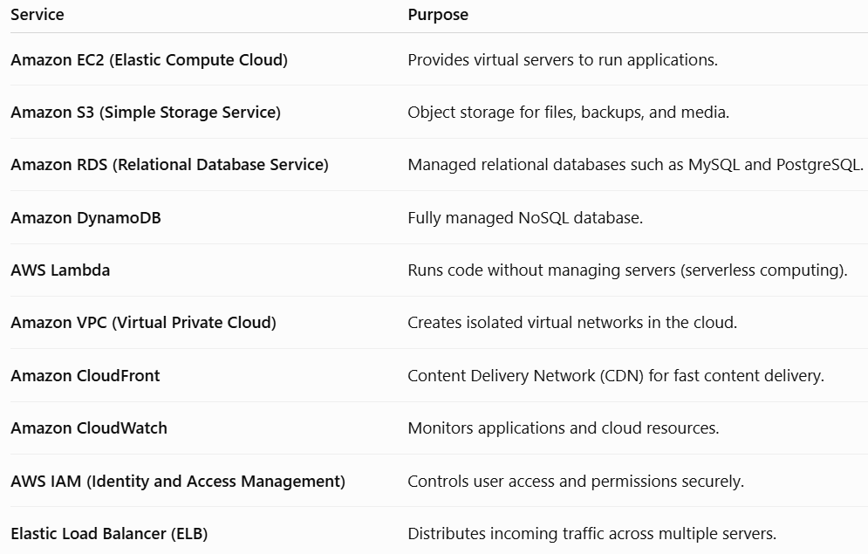
Cloud computing platforms and technologies
Core Amazon Web Services (AWS) Services:

Slide 25
Cloud computing platforms and technologies
AWS Service Categories
Compute: EC2, Lambda, Elastic Beanstalk
Storage: S3, EBS, Glacier
Databases: RDS, DynamoDB, Aurora
Networking: VPC, Route 53, CloudFront
Security: IAM, AWS Shield, AWS WAF
Analytics: Redshift, Athena, EMR
Machine Learning: Amazon SageMaker
Monitoring: CloudWatch, CloudTrail

Slide 26
Cloud computing platforms and technologies
Advantages of AWS:
Highly scalable and flexible
Strong security and compliance
Global availability with multiple regions
Wide range of cloud services
Reliable and fault-tolerant infrastructure
Large developer community and documentation

Slide 27
Cloud computing platforms and technologies
Common Use Cases:
Web and mobile application hosting
Data backup and disaster recovery
Big data analytics
Artificial intelligence and machine learning
Internet of Things (IoT)
Media streaming and content delivery
Enterprise application deployment

Slide 28
Cloud computing platforms and technologies
Benefits of Learning AWS:
High demand in the IT industry
Widely used by startups and enterprises
Valuable for careers in cloud computing, DevOps, software development, and data engineering
Offers certifications such as:
AWS Certified Cloud Practitioner
AWS Certified Solutions Architect – Associate
AWS Certified Developer – Associate
AWS Certified SysOps Administrator – Associate

Slide 29
Cloud computing platforms and technologies
Microsoft Azure
Microsoft Azure is a cloud computing platform and service created by Microsoft. It provides on-demand cloud services such as computing, storage, networking, databases, analytics, artificial intelligence (AI), and security. Azure helps organizations build, deploy, and manage applications through Microsoft's global network of data centers.
Key Features
Scalability: Increase or decrease resources as needed.
High Availability: Reliable services with global data centers.
Security: Built-in identity management, encryption, and compliance features.
Hybrid Cloud Support: Integrates on-premises infrastructure with cloud services.
Pay-as-You-Go Pricing: Pay only for the resources you use.

Slide 30
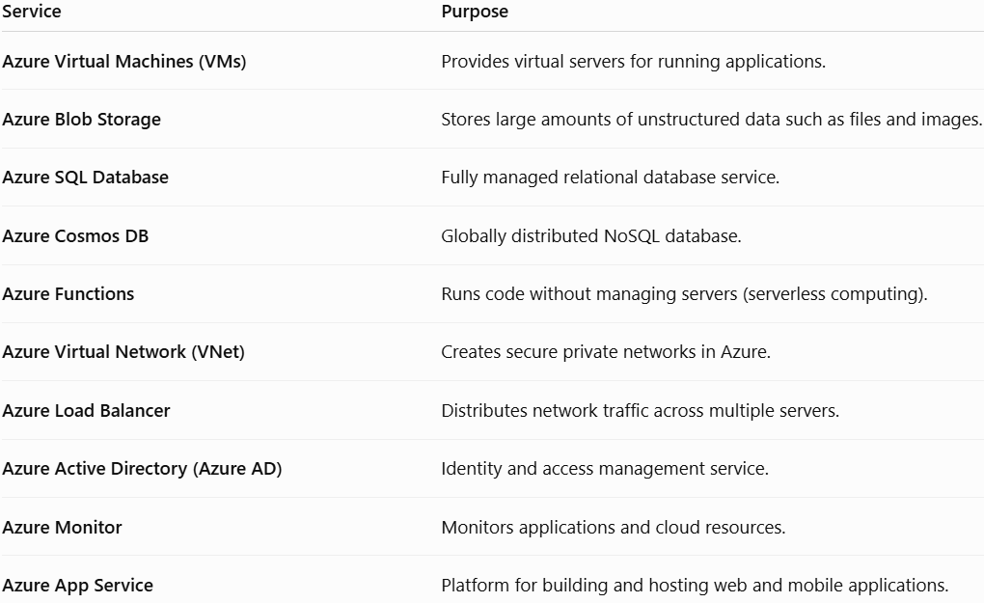
Cloud computing platforms and technologies
Core Azure services:

Slide 31
Cloud computing platforms and technologies
Azure Service Categories
Compute: Virtual Machines, App Service, Azure Functions
Storage: Blob Storage, Disk Storage, File Storage
Databases: Azure SQL Database, Cosmos DB, MySQL, PostgreSQL
Networking: Virtual Network, Load Balancer, VPN Gateway
Security: Microsoft Entra ID (formerly Azure AD), Microsoft Defender for Cloud, Azure Key Vault
Analytics: Azure Synapse Analytics, Azure Data Lake
AI & Machine Learning: Azure Machine Learning, Azure AI Services
Monitoring: Azure Monitor, Log Analytics

Slide 32
Cloud computing platforms and technologies
Advantages of Microsoft Azure
Excellent integration with Windows Server and Microsoft products
Strong hybrid cloud capabilities
High security and regulatory compliance
Global network of data centers
Supports multiple programming languages and frameworks
Cost-effective with flexible pricing options

Slide 33
Cloud computing platforms and technologies
Common Use Cases
Hosting web and mobile applications
Backup and disaster recovery
Virtual desktops
AI and machine learning applications
Big data analytics
Internet of Things (IoT)
Enterprise application modernization

Slide 34
Cloud computing platforms and technologies
Benefits of Learning Azure:
Widely used by enterprises, especially those using Microsoft technologies.
High demand for cloud, DevOps, and system administration roles.
Strong integration with Microsoft 365, Windows Server, and Active Directory.
Valuable certifications include:
Microsoft Certified: Azure Fundamentals (AZ-900)
Azure Administrator Associate (AZ-104)
Azure Developer Associate (AZ-204)
Azure Solutions Architect Expert (AZ-305)

Slide 35
Cloud computing platforms and technologies
Google Cloud Platform (GCP)
Google Cloud Platform (GCP) is a cloud computing platform provided by Google. It offers on-demand cloud services such as computing, storage, databases, networking, artificial intelligence (AI), machine learning (ML), analytics, and application development. GCP runs on the same global infrastructure that powers Google's own services, such as Search, Gmail, and YouTube.
Key Features:
Scalability: Automatically scales resources based on workload.
High Performance: Uses Google's high-speed global network.
Security: Built-in encryption, identity management, and compliance features.
Pay-as-You-Go Pricing: Pay only for the resources used.
AI & Data Analytics: Strong support for machine learning and big data.

Slide 36
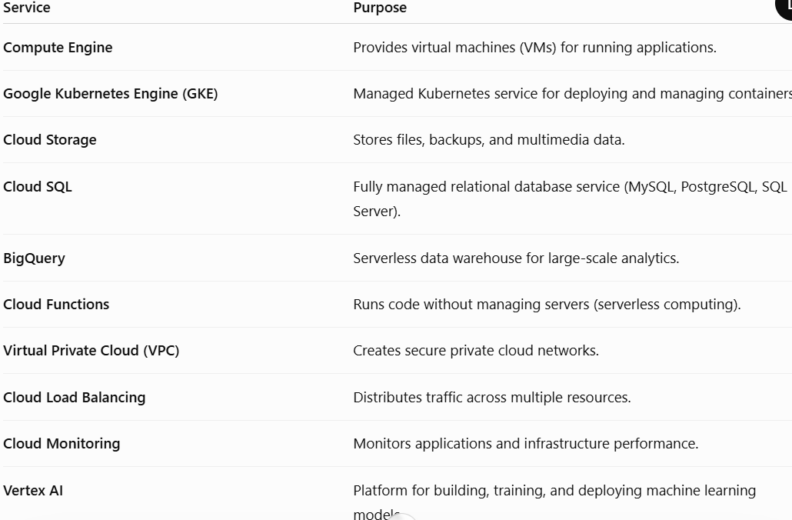
Cloud computing platforms and technologies
Core GCP services:

Slide 37
Cloud computing platforms and technologies
GCP Service Categories:
Compute: Compute Engine, App Engine, Cloud Functions
Storage: Cloud Storage, Persistent Disk
Databases: Cloud SQL, Firestore, Bigtable, Spanner
Networking: VPC, Cloud Load Balancing, Cloud DNS
Security: Identity and Access Management (IAM), Cloud Armor, Secret Manager
Analytics: BigQuery, Dataflow, Dataproc
AI & Machine Learning: Vertex AI, Vision AI, Speech-to-Text
Monitoring: Cloud Monitoring, Cloud Logging

Slide 38
Cloud computing platforms and technologies
Advantages of GCP:
High-speed global network infrastructure
Excellent support for AI, ML, and data analytics
Fully managed Kubernetes with GKE
Automatic scaling for applications
Strong security and compliance
Cost-effective pricing with sustained-use discounts

Slide 39
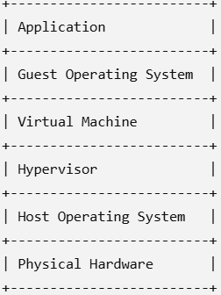
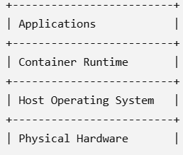
Cloud computing platforms and technologies
Common Use Cases:
Hosting web and mobile applications
Data warehousing and analytics
Machine learning and AI applications
Containerized application deployment
Big data processing
Backup and disaster recovery
Internet of Things (IoT)
Virtual Machine Architecture
Container Architecture

Slide 40
Cloud computing platforms and technologies
Benefits of Learning GCP
Widely used for AI, machine learning, and data engineering.
Strong demand for cloud engineers, data engineers, and DevOps professionals.
Popular in organizations using Kubernetes and modern cloud-native applications.
Valuable certifications include:
Google Cloud Digital Leader
Associate Cloud Engineer
Professional Cloud Architect
Professional Data Engineer

Slide 41
Cloud computing platforms and technologies
Advantages:
Scalability and flexibility
Cost savings (pay-as-you-go)
High availability and reliability
Enhanced security features
Automatic updates and maintenance
Global accessibility

Slide 42
Cloud computing platforms and technologies
Common Use Cases:
Hosting websites and web applications
Data backup and disaster recovery
Machine learning and artificial intelligence
Big data analytics
Internet of Things (IoT) applications
Mobile application backends
Software development and testing
Among these, AWS, Azure, and Google Cloud Platform (GCP) are the three most widely used cloud computing platforms worldwide, offering comprehensive services suitable for startups, enterprises, and government organizations.

Slide 43
Cloud computing platforms and technologies
Cloud computing technologies:
Cloud computing technologies are the tools, architectures, and methods that enable the delivery of computing services over the internet. They support scalable, flexible, and cost-effective IT infrastructure.
Key Cloud Computing Technologies
1. Virtualization
Creates virtual versions of servers, storage, and networks.
Allows multiple virtual machines (VMs) to run on a single physical server.
Examples: VMware, Hyper-V, KVM(Kernel Based VM).

Slide 44
Cloud computing platforms and technologies
Key Cloud Computing Technologies
2. Containerization
Packages applications and their dependencies into lightweight containers.
Ensures applications run consistently across different environments.
Examples: Docker, Podman.
3. Orchestration
Automates the deployment, scaling, and management of containers.
Example: Kubernetes.

Slide 45
Cloud computing platforms and technologies
Key Cloud Computing Technologies
4. Cloud Storage
Stores data securely on remote servers accessible over the internet.
Types include object, block, and file storage.
Examples: Amazon S3, Azure Blob Storage, Google Cloud Storage.
5. Serverless Computing
Allows developers to run code without managing servers.
Resources are automatically allocated and scaled.
Examples: AWS Lambda, Azure Functions, Google Cloud Functions.

Slide 46
Cloud computing platforms and technologies
Key Cloud Computing Technologies
6. Microservices
Develops applications as a collection of small, independent services.
Improves scalability, maintainability, and fault isolation.
7. DevOps and CI/CD(Continuous Integration/Continuous Delivery or Deployment)
Integrates development and operations for faster software delivery.
CI/CD automates building, testing, and deployment.
Tools: Jenkins, GitHub Actions, GitLab CI.

Slide 47
Cloud computing platforms and technologies
Key Cloud Computing Technologies
8. Software-Defined Networking (SDN)
Separates network control from hardware.
Enables programmable and flexible network management.
9. Artificial Intelligence (AI) and Machine Learning (ML)
Cloud platforms provide AI/ML services for prediction, automation, and analytics.
Examples include image recognition, chatbots, and recommendation systems.
10. Big Data Analytics
Processes and analyzes large datasets using cloud-based tools.
Technologies: Hadoop, Apache Spark, BigQuery.

Slide 48
Cloud computing platforms and technologies
Key Cloud Computing Technologies
11. Edge Computing
Processes data closer to where it is generated instead of relying solely on centralized cloud servers.
Reduces latency and improves real-time performance.
12. Internet of Things (IoT)
Connects smart devices to cloud platforms for data collection, monitoring, and control.

Slide 49
Types of Clouds
When discussing the types of clouds, the industry looks at this through two distinct lenses: Deployment Models (how the cloud is hosted and who has access) and Service Models (what resources you are actually renting).
Here is the breakdown of the different types you will encounter.
1. Cloud Deployment Models
These models define where the infrastructure is located and who manages it.
Public Cloud
The most common type of cloud computing. Resources (like servers and storage) are owned and operated by a third-party provider and shared with other organizations (called "tenants") over the public internet.

Slide 50
Types of Clouds
Here is the breakdown of the different types you will encounter.
1. Cloud Deployment Models
Public Cloud
The most common type of cloud computing. Resources (like servers and storage) are owned and operated by a third-party provider and shared with other organizations (called "tenants") over the public internet.
Pros: Lower costs (pay-for-use), zero maintenance, near-infinite scalability.
Cons: Less control over hardware, potential data residency issues.
Examples: Amazon Web Services (AWS), Microsoft Azure, Google Cloud.

Slide 51
Types of Clouds
Here is the breakdown of the different types you will encounter.
1. Cloud Deployment Models
Private Cloud
Infrastructure dedicated solely to a single organization. It can be physically located at your company's on-site data center or hosted by a third-party provider.
Pros: Highest security, total customization, and compliance control.
Cons: Very expensive; your IT team is responsible for maintenance and upgrades.
Examples: OpenStack, VMware Cloud, HPE GreenLake.

Slide 52
Types of Clouds
Here is the breakdown of the different types you will encounter.
1. Cloud Deployment Models
Hybrid Cloud
This bridges the gap by combining a public cloud and a private cloud (or on-premises infrastructure), allowing data and apps to move seamlessly between them.
Pros: Ultimate flexibility. You can keep sensitive financial data on a private server but use the public cloud to run high-traffic web apps.
Cons: Complex to set up, manage, and secure.

Slide 53
Types of Clouds
Here is the breakdown of the different types you will encounter.
1. Cloud Deployment Models
Multi-Cloud
While often confused with hybrid cloud, multi-cloud is the practice of using two or more public cloud providers at the same time.
Pros: Prevents vendor lock-in and protects against a single provider going down.
Cons: Managing different provider dashboards and tools increases operational complexity.
Example: Using AWS for web hosting but Google Cloud for its advanced AI and data analytics tools.

Slide 54
Types of Clouds
Here is the breakdown of the different types you will encounter.
1. Cloud Deployment Models
Community Cloud
A collaborative space where infrastructure is shared by several organizations with similar concerns (such as security compliance, jurisdiction, or mission).
Example: A shared cloud environment used exclusively by multiple government agencies or a network of hospitals.

Slide 55
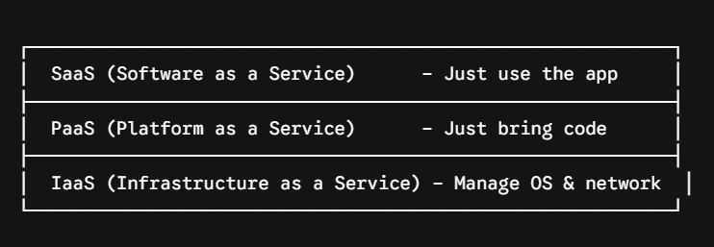
Types of Clouds
Here is the breakdown of the different types you will encounter.
2. Cloud Service Models (The "As-a-Service" Stack)
These models define the level of control and flexibility you have over your cloud environment.

Slide 56
Types of Clouds
Here is the breakdown of the different types you will encounter.
2. Cloud Service Models (The "As-a-Service" Stack)
Infrastructure as a Service (IaaS): You rent the raw building blocks—virtual servers, storage, and networking. You are responsible for installing the Operating System and software. (Examples: AWS EC2, Azure VMs)
Platform as a Service (PaaS): The provider manages the hardware and the OS. You just bring your code. It is built entirely for developers. (Examples: Heroku, AWS Elastic Beanstalk)
Software as a Service (SaaS): A complete, fully functional software application that you access via a web browser or app. (Examples: Gmail, Microsoft 365, Netflix)

Slide 57
Cloud Applications
Cloud applications are software programs that run on cloud computing platforms instead of being installed and executed entirely on a local computer. They use remote servers over the internet to provide services such as storage, processing, and collaboration.
Examples of Cloud Applications:
Email: Gmail, Outlook.com
Storage: Google Drive, Dropbox, OneDrive
Office Suites: Google Docs, Microsoft 365
Video Conferencing: Zoom, Microsoft Teams
Customer Relationship Management (CRM): Salesforce
Streaming Services: Netflix, Spotify

Slide 58
Cloud Applications
Characteristics:
Accessible from anywhere with an internet connection.
Data is stored on remote cloud servers.
Automatically updated by the service provider.
Scalable to meet changing user demands.
Supports collaboration among multiple users in real time.

Slide 59
Cloud Applications
Advantages:
Lower infrastructure and maintenance costs.
Easy scalability and flexibility.
High availability and reliability.
Automatic backup and disaster recovery.
Access from multiple devices.
Disadvantages:
Requires a stable internet connection.
Potential security and privacy concerns.
Limited control over infrastructure.
Possible downtime if the cloud provider experiences outages.
Cloud applications are widely used in education, business, healthcare, banking, entertainment, and government services because they provide convenient, cost-effective, and scalable solutions.

Slide 60
Cloud Applications
A true cloud application isn't just an old desktop app hosted on the internet.
Modern cloud apps rely on Cloud-Native Architecture, which usually features:
Microservices: Instead of building the app as one massive, heavy block of code (a monolith), it is broken down into small, independent services (e.g., one service handles user logins, another handles payment processing).
Containerization: Tools like Docker package the code and its dependencies together so the app runs exactly the same way on a developer's laptop as it does on a massive cloud server.
API-Driven Integration: Applications easily "talk" to one another.
For example, an e-commerce cloud app uses an API to instantly ping a third-party shipping service like FedEx to calculate delivery costs.

Slide 61
Cloud Applications
The AI Bottleneck: Generative AI features are being built into almost every SaaS application. However, because AI model training and inference are incredibly expensive, cloud apps are increasingly moving toward hybrid architectures—processing sensitive or massive datasets locally or on specialized hardware, and using the cloud for scaling.
Edge Computing Integration: For applications that require zero delay (like autonomous driving software, smart factories, or real-time gaming), processing is moving away from centralized data centers to the "edge" of the network, closer to the actual user device.

Slide 62
Virtualization Concepts
At its simplest, virtualization is the process of creating a software-based (virtual) representation of something physical—like virtual servers, storage, networks, or desktops.
It is the underlying engine that makes cloud computing possible. Instead of dedicating an entire physical computer to just one task or operating system, virtualization allows you to chop up that single physical machine into multiple, isolated secure environments.

Slide 63
Virtualization Concepts
Need for Virtualization
Without virtualization:
One server can run only one operating system.
Hardware resources remain underutilized.
High infrastructure cost.
Difficult to manage multiple applications.
With virtualization:
Multiple operating systems run simultaneously.
Better utilization of CPU, memory, and storage.
Lower hardware and maintenance cost.
Easy resource allocation.

Slide 64
Virtualization Concepts

Slide 65
Virtualization Concepts
Core Virtualization Concepts
To understand how this works, you only need to know three core components: the Host, the Guest, and the Hypervisor.
The Host: The actual, physical computer hardware (CPU, RAM, hard drives) providing the real computing power.
The Guest: The virtual environment running inside the host. This is typically referred to as a Virtual Machine (VM). The VM thinks it is a real computer with its own dedicated hardware, even though it's just software.
The Hypervisor (Virtual Machine Monitor / VMM): The crucial software layer that sits between the physical hardware and the VMs. It intercepts requests from the VMs and safely allocates CPU, memory, and storage from the host.

Slide 66
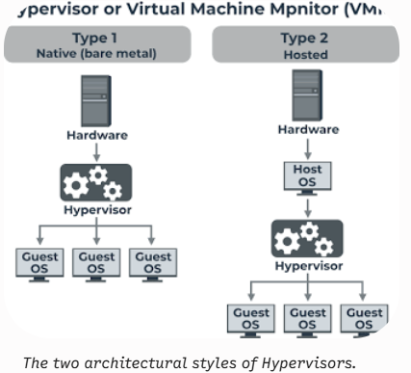
Virtualization Concepts
The Two Types of Hypervisors
As shown in the architectural diagram below, hypervisors manage resources differently depending on where they sit in the technology stack:

Slide 67
Virtualization Concepts
The Two Types of Hypervisors
Type 1 (Bare-Metal): Sits directly on top of the physical hardware. Because there is no middle-man operating system, it is incredibly fast, secure, and efficient. This is what data centers and cloud providers (like AWS or Azure) use.
Examples: VMware ESXi, Microsoft Hyper-V, KVM.
Type 2 (Hosted): Sits on top of an existing Operating System (like Windows or macOS). It is much easier to set up for regular users but suffers a performance penalty because everything must pass through the host OS first.The operating system is usually unaware of the virtualization
Examples: VirtualBox, VMware Workstation, Parallels Desktop.

Slide 68
Types of Virtualization
Virtualization isn't just limited to splitting up a server. It can be applied across the entire computing infrastructure.
Primary Types of Virtualization
1. Server Virtualization
The most common type. A single physical server is masked into multiple virtual servers. It solves the "server sprawl" problem where companies used to buy a brand new physical server for every individual application they ran, resulting in massive wasted computer power.
2. Desktop Virtualization (VDI)
Instead of running an operating system locally on a user’s laptop, the desktop environment lives on a remote server. The user logs in via a web browser or a thin client. This allows IT departments to manage, update, and secure thousands of employee laptops from one central dashboard.

Slide 69
Types of Virtualization
3. Network Virtualization
This decouples network software from the underlying physical switches and routers. It allows administrators to create virtual networks (like subnets, firewalls, and VPNs) instantly through software, without manually plugging in cables.
4. Storage Virtualization
This takes multiple physical hard drives from different storage arrays and pools them together so they appear as a single, massive storage device. It makes allocating space to different apps incredibly flexible.

Slide 70
Types of Virtualization
5. Application Virtualization
Applications run in isolated environments without full installation on the client.
Examples:
Microsoft App-V,VMware ThinApp
Advantages:
No installation conflicts
Easy deployment
Simplified updates

Slide 71
Types of Virtualization
6. OS-Level Virtualization (Containers)
Multiple isolated environments share the same host operating system kernel.
Examples:
Docker
LXC
Podman
Advantages:
Fast startup
Lightweight
Low resource usage

Slide 72
Advantages of Virtualization
Better resource utilization
Cost reduction
Scalability
High availability
Disaster recovery
Faster deployment
Easy backup and restoration
Workload isolation
Live migration of VMs
Energy efficiency

Slide 73
Disadvantages of Virtualization
Performance overhead compared to bare metal
Single point of failure if host hardware fails (without redundancy)
Licensing costs for some hypervisors
Management complexity
Resource contention among VMs
Security risks if the hypervisor is compromised

Slide 74
Applications of Virtualization
Cloud computing platforms
Data centers
Software testing and development
Disaster recovery
Server consolidation
Web hosting
Educational laboratories
Enterprise IT infrastructure

